Slide 1
ABOUT THE THEME
Filipino CPAs RISING in Solidarity Amidst Challenging Times
The world, in general, and the Philippines, in particular, are literally at a standstill and are effectively frozen because of the pandemic brought about by COVID-19. We are in the midst of a new battle between public health and commerce. According to the World Health Organization (WHO), COVID-19 may persist “on and off” until the vaccine is developed and widely distributed. We, therefore, brace ourselves to so many possibilities. A large number of MSMEs will close down due to loss of income and loss of aggregate demand, both domestic and international markets. A large number of workers will be retrenched, resulting in a much higher unemployment rate in the next two (2) years. It may take 2-3 years before the Philippines can return to normal.
Some writers say, “the truth is that almost everyone knows nothing and almost everything is just a guess,”. Our profession, like many others, is not spared from all the hurdles. The immediate challenges and obstacles faced by the four (4) sectors of our profession, namely: academe, commerce and industry, government, and public practice, are to be dealt with squarely. We stand in solidarity as we make ourselves relevant to our country despite the hardships that we encounter at our inner core, from our family life, to work life, to spiritual life. With the “new normal”, we are left with only one choice and that choice is to continue the fight against the virus by making ourselves virus-free, by boosting our immune system, by observing all the proper health protocols, and by educating others the proper way of dealing COVID-19 because no matter how we protect ourselves, our enemy is invisible.

Slide 2
ABOUT THE THEME
Filipino CPAs RISING in Solidarity Amidst Challenging Times
Sudden major impacts of the perceived "new norm” to the Accounting Profession in our day-to-day work include Work From Home (WFH) arrangements, virtual meetings, and virtual training. We should continue to deliver our mandate as CPAs as seamlessly as we can, notwithstanding the difficulties. RISING, the 6-point agenda for FY 2020-2021, where R represents Recovery Programs; I represents Inhouse Programs and Innovations; S represents Social Responsibility Programs; I represents International Linkages; N represents New Programs; and G represents on-Going Programs and Governance, befits action with optimism as we rise above overcoming the fears of uncertainties in the middle of trying times. We rise together by first acknowledging the heroic acts of people during the pandemic, from whom we draw inspiration and motivation. We rise together to reflect how our community and the world have come together with resilience and compassion. We rise in solidarity as we support each other in bouncing back from economic and non-economic downfall.
In times of upheaval, such as this unprecedented pandemic, we can get into a headspace to imagine a more hopeful future. Although there are many obstacles in life, hope allows us to approach them with a success mindset. It helps us to get closer to our goals despite the ups and downs of life. As it can be said by Pittacus Lore, “Even when the world throws its worst and then turns its back, there is still always hope.”

Slide 3
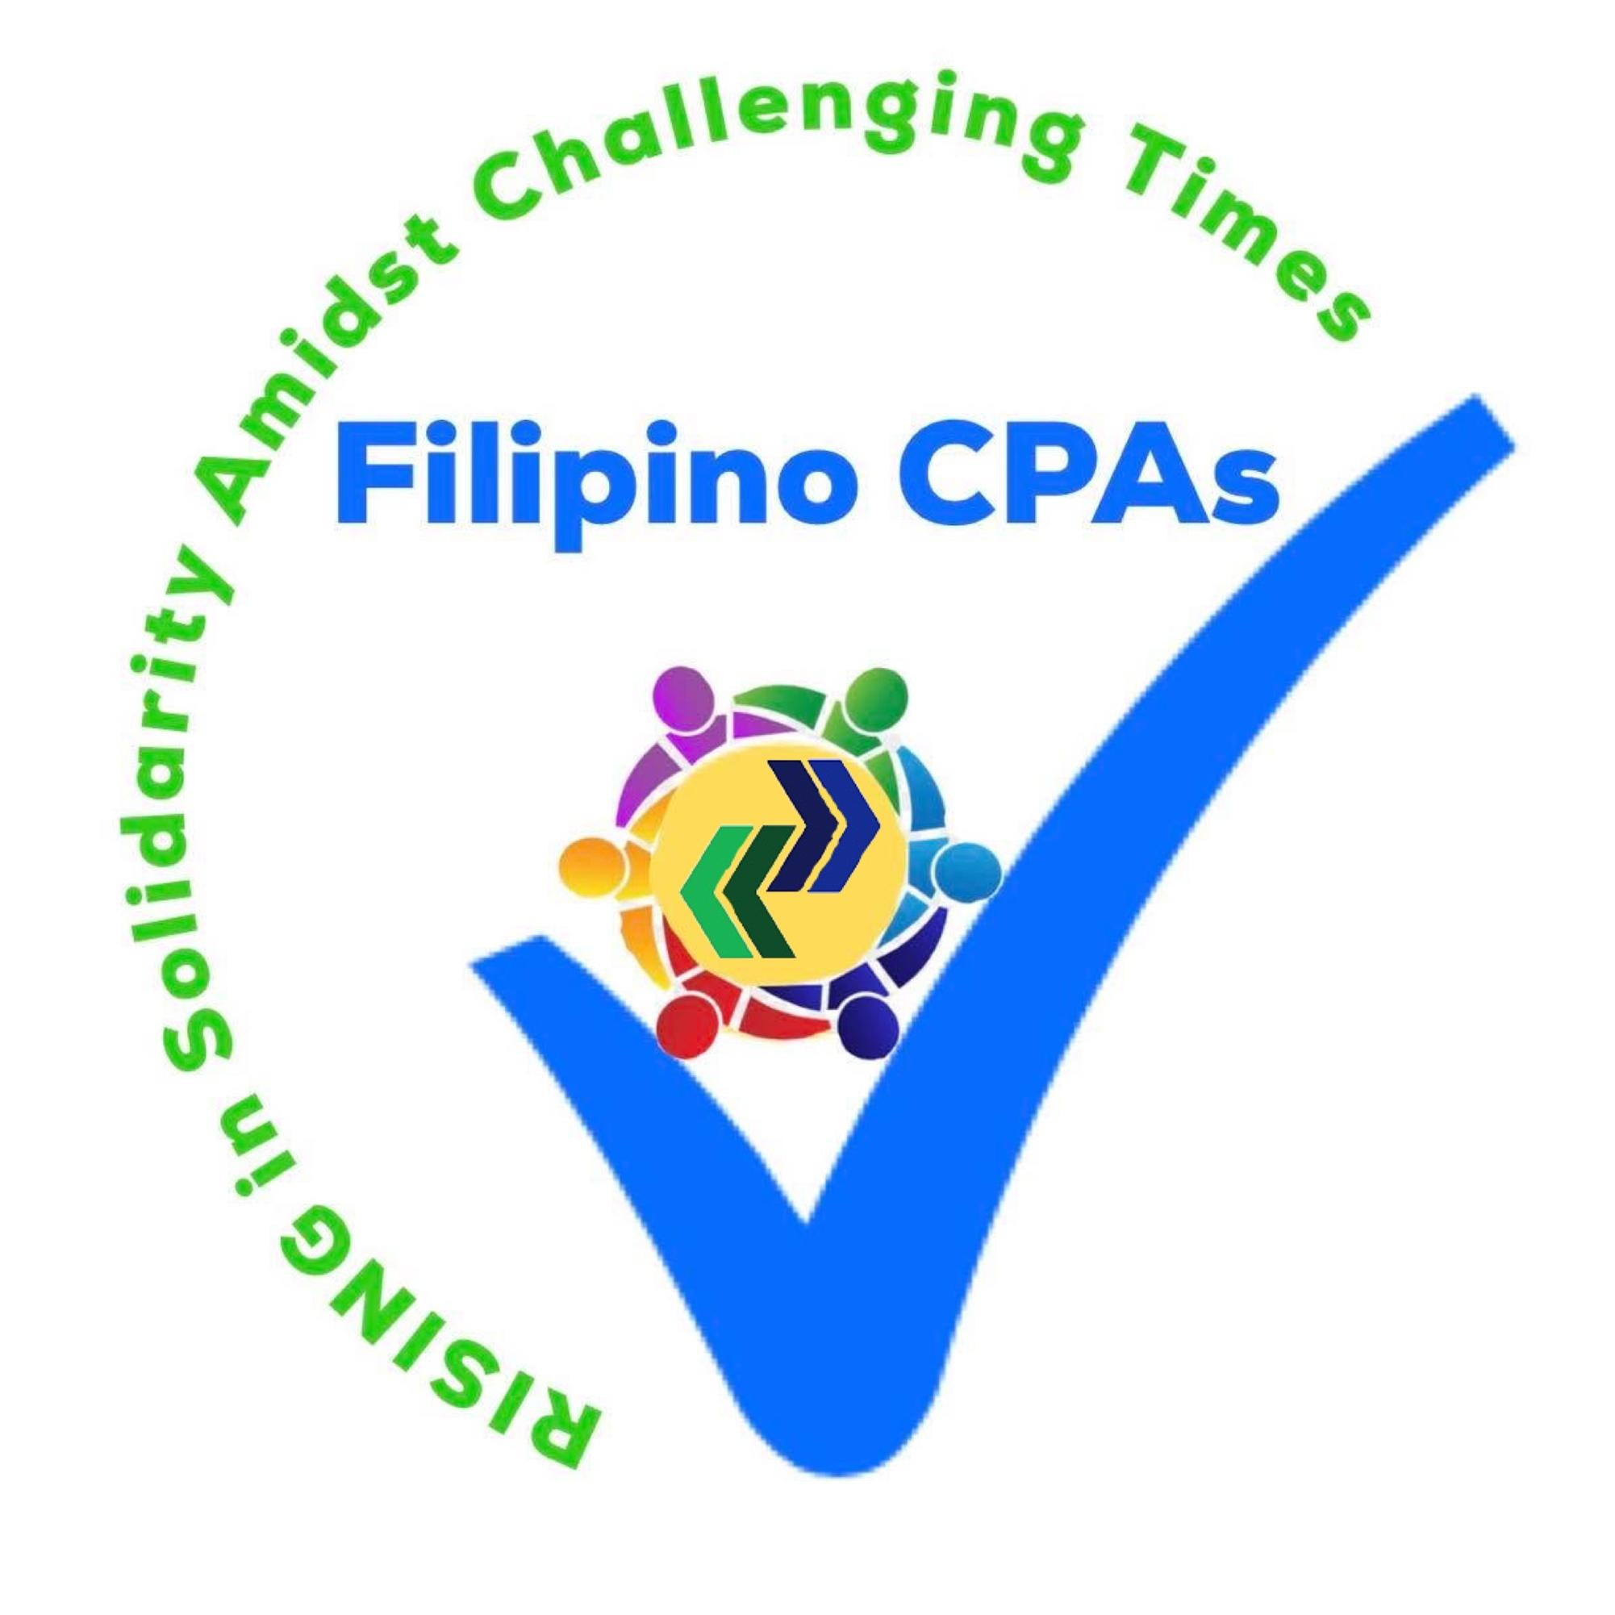
THE LOGO

